Slide 1

Javascript DOM
M3-08
Participate! The more engagement the better! You are NEVER interrupting me!

Slide 2
Session Objectives
Document Object Model (DOM)
DOM Traversal
DOM Manipulation
HTML Templates

Slide 3

In class today, we will programmatically build out this page using javascript using data from a JSON object that contains an array of reviews. We will start with minimal HTML/CSS.

Slide 4
Document Object Model (DOM)
Document Object Model (DOM) is a programming interface for the graphical representation of documents that are loaded into the browser. It provides a way to access and manipulate the structure, style, and content once loaded.
The HTML source is not the DOM
The HTML is parsed once when the page is loading and turned into the DOM.
CSS and JavaScript select elements in the DOM, not the HTML
The representation of the DOM is the what is shown in the browser Development Tools
Do not try to manipulate the DOM until everything is loaded (more info tomorrow).

Slide 5
Document Object Model (DOM)
It provides a way to access and manipulate the structure, style, and content once loaded.
JavaScript can change all the HTML elements in the page
JavaScript can change all the HTML attributes in the page
JavaScript can change all the CSS styles in the page

Slide 6
Document Object Model (DOM)?
It provides a way to access and manipulate the structure, style, and content once loaded.
JavaScript can remove existing HTML elements and attributes
JavaScript can add new HTML elements and attributes
JavaScript can react to all existing HTML events in the page
JavaScript can create new HTML events in the page

Slide 7
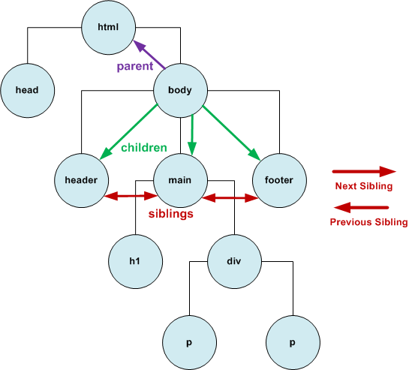
Nodes
HTML
<html> <head></head> <body> <header></header> <main> <h1>jhgjhg</h1> <div> <p>text</p> <p></p> </div> </main> <footer></footer> </body> </html>

Slide 8
Nodes
The DOM represents the page in a Tree Structure
The top node is called the root (or root node)
Every node, except the root node, has 1 parent
Each node can have any number of children
Nodes with the same parent are called siblings
While the DOM representation often follows HTML, it may have extra nodes

Slide 9
Nodes vs Elements?
A node is the generic name for any type of object in the DOM hierarchy.
An element is a specific type of node, one that can be directly specified in the HTML with an HTML tag and can have properties like an id or a class. can have children, etc. (ex: <p id=”123”/>
Examples of nodes that are not elements (document, comments, text nodes(e.g text between two tags, but not the tags themselves))

Slide 10
Document object
The document object is a built-in object that has many properties and methods that we can use to access and modify the webpage’s DOM structure
Using inspect tool in Google chrome, we can access a page’s DOM by typing ‘document’ in the console:
> document → retrieves the whole document object
> document.body → retrieves the body object
We can also access the document via Javascript which we will see in a little bit.

Slide 11
What is getElementById()?
Syntax:
element = document.getElementById(id);
Returns a reference to the element by its ID. If the element with the specified ID is not in the document, it will returns null.

Slide 12
What is querySelector() and querySelectorAll()? Syntax:
element = document.querySelector(css selectors);
Returns the first element within the document that matches the specified css selector, or null if no matches are found.
document.querySelectorAll() will select all the matches.

Slide 13
<body> <h1>Programming Languages</h1>
<ul>
<li id="web-id">PHP</li>
<li>HTML</li>
<li class="web-class">CSS</li>
<li class="web-class">JavaScript</li>
</ul> </body>
To get the HTML content of the first li, whose id is web-id, with getElementById:
document.getElementById('web-id').innerHTML;
Now with querySelector:
document.querySelector('#web-id').innerHTML; OR... document.querySelector('ul li#web-id').innerHTML;

Slide 14
innerText, innerHTML, textContent
3 Ways of setting text:
document.getElementById("main-title").innerHTML = 'My Title';
document.getElementById("main-title").innerText = 'My Title';
document.getElementById("main-title").textContent = 'My Title';
innerHTML - Allows you to add text or html. However, can increase the chance of someone injecting a Cross Site Scripting attack if you do it on a user input node (textbox, or other form field). Should be avoided on forms.
innerText - Will safely encode your text as a ‘text’ and node code. However you can’t embed HTML using this method, and there is a slight performance hit as the encoding takes place.
textContent - Doesn’t have the security issues that innerHTML has while allowing HTML to be added, and is lightweight making it a better choice overall.

Slide 15
Placeholder to go to lecture code….

Slide 16
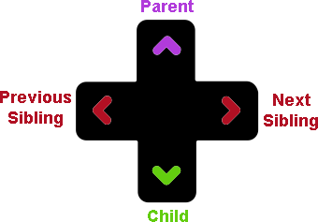
DOM Transversal
DOM Navigation on W3Schools
Moving around the DOM using the relationship of the nodes
Always start with the document node
Get Element
By ID: document.getElementById(‘id’)
By Selector: document.querySelector(‘css selector’)
a single item that matches the css selector
querySelectorAll()
return an array that matches the css selector
Select another element by Relationship
firstChild, lastChild
firstElementChild, lastElementChild
nextSibling, previousSibling
parent, child
childNodes[index]
Node: representations of the HTML document, but may not match the HTML exactly Element: representation of an HTML tag

Slide 17
Creating An Element
Create Element - returns a node object that we can then append to another node object.
document.createElement(‘div’);
Can manipulate the element
setAttribute()
classList()
add, remove, contains
Vanilla JavaScript
JavaScript that does not rely on outside libraries or frameworks.

Slide 18
insertAdjacentElement()
element.insertAdjacentElement(position, element);
position
A DOMString representing the position relative to the element; must be one of the following strings:
'beforebegin': Before the element itself.
'afterbegin': Just inside the element, before its first child.
'beforeend': Just inside the element, after its last child.
'afterend': After the element itself.
<!-- beforebegin -->
<p>
<!-- afterbegin -->
foo
<!-- beforeend -->
</p>
<!-- afterend -->0
element The DOM element to be inserted into the tree

Slide 19
Adding/Removing Elements
insertAdjacentElement(), insertAdjacentText(), insertAdjacentHTML()
appendChild()
adds the new element as a new child to selected element - same position as beforeend
removeChild()
Removes a child element
insertRow(), insertCell()
used with tables
insertBefore()
inserts an element before the selected child of the current element

Slide 20
HTML Templates
Allows us to define HTML that is included in the DOM for manipulation, but not rendered on the page
Copy the template, manipulate it, and insert the updated copy into the DOM as regular elements that are rendered
document.getElementById('review-template').content.cloneNode(true);
content.cloneNode( true/false )
true - deep copy (includes children and ancestors)
false - shallow copy (just the node without its children)
Many older browsers do not support templates, so must always verify they are supported for using them in our JavaScript

Slide 21
Exercise

Slide 22
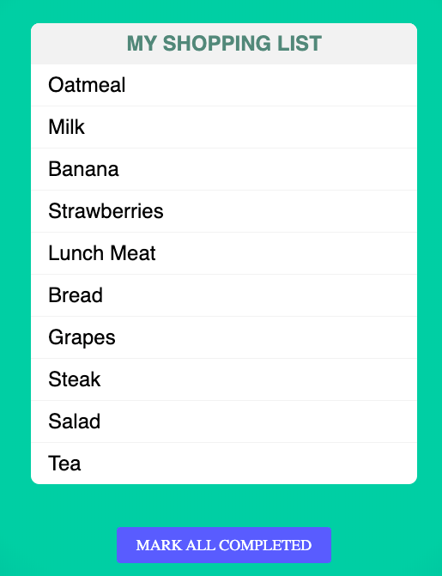
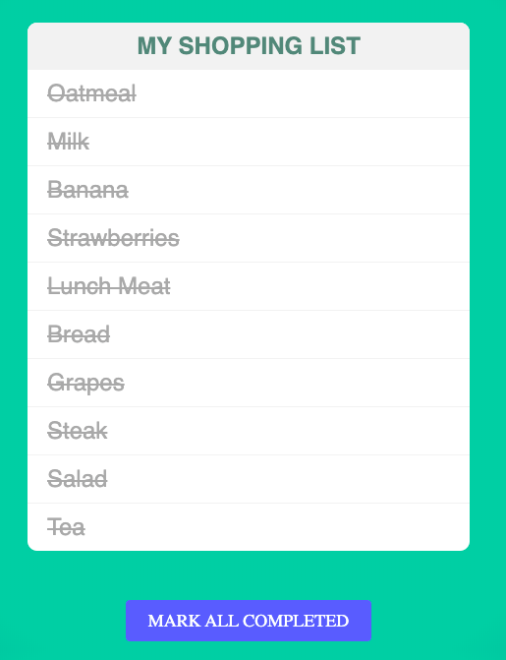

Slide 23
Resources:
This is a multi-part tutorial on DOM, DOM Traversal/Manipulation, etc
https://www.digitalocean.com/community/tutorial_series/understanding-the-dom-document-object-model

